Slide 1
WELCOME

Slide 2

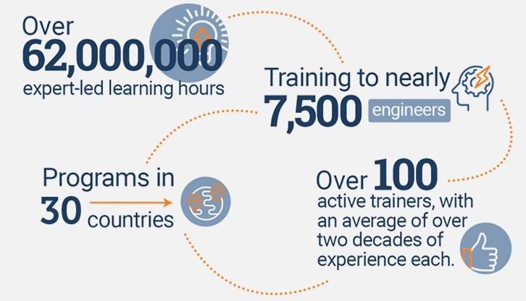
An Overview
Our purpose…
We help organizations learn and adopt new technologies.
In 2018 alone...
…Impacts you daily.
When you talk on the phone, watch a movie, connect with friends on social media, drive a car, fly on a plane, pay with a credit card, shop online, and order a latte with your mobile app, you are interacting with technology developed by one of our customers.
Notes:
Share a bit about DevelopIntelligence
- As developers you want to learn!
- As a corporation you want your developers to align their learning with your business goals.
- That’s where we come in… Keeping developers current, bringing others up-to-speed … all aimed at moving your business forward!
- We started in 2003 by a Sun Microsystems developer that wanted to help developers level-up and see business better leverage IT

Slide 3
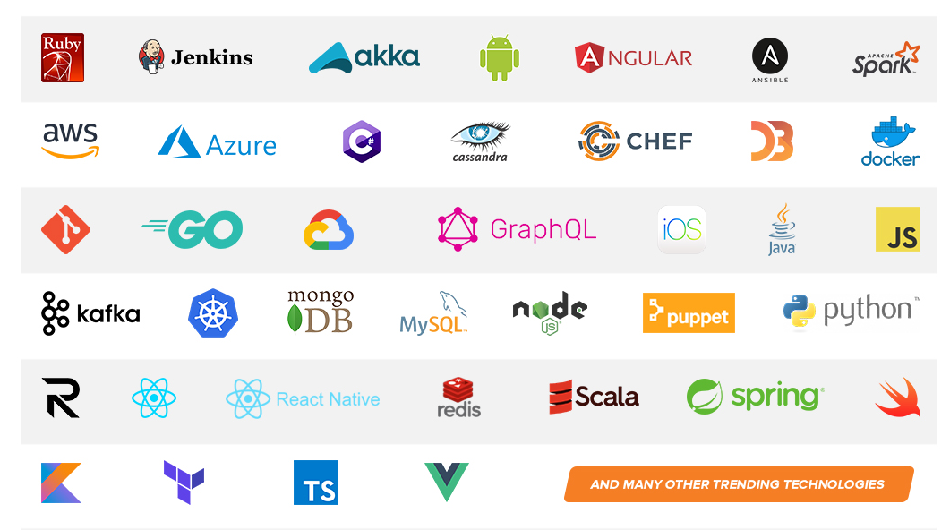
Technologies we cover
Notes:
Areas of DevelopIntelligence expertise
DevOps: Ansible / Jenkins
BigData: Hadoop / Cassandra / Spark
Machine Learning
Front-end: React / Angular
Cloud: AWS / Azure / Google Cloud
- Started as a Java shop -> keep growing -> haven’t looked back
- Our specialty is hiring expert practitioners that can come alongside teams and teach them how to move forward

Slide 4
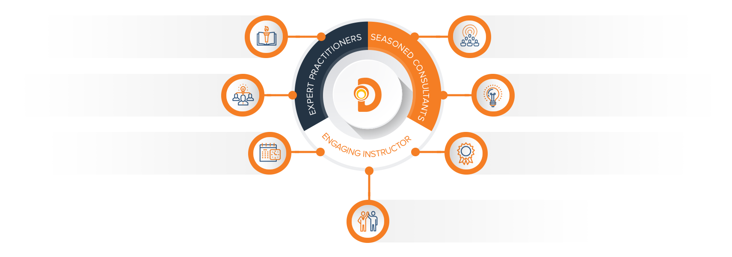
Our Practitioners
250 best selling
books authored
150 engagements speaking
at industry conferences
9+ years of training
experience
Over 17 years of industry
experience per instructor
750,000 practitioner led
training hours
125 certifications in leading
technologies
95% instructor satisfaction

Slide 5


About the instructors

Slide 6
Data Engineers and ETL
Kerry Nakayama

Slide 7

Data Engineers
Notes:
Let’s hear a little bit about the class.
Name
job title
experience
what you hope to gain from the class today?

Slide 8
What is the difference?
Notes:
So what are the differences between a data engineer, data analyst and the new hot job data scientist

Slide 9
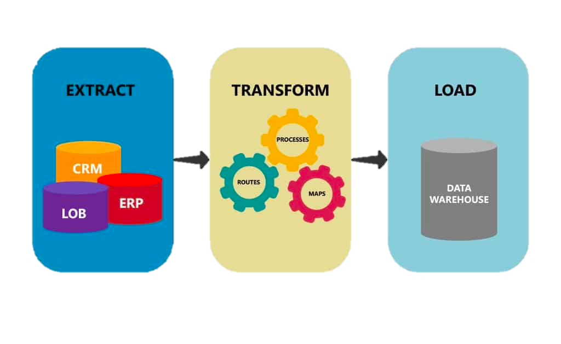
Extract, Transform, and Load
Notes:
The most essential fundamentals can be boiled down to 3 letters ETL
Give me your 10 second spiel on each component
Data extraction involves extracting data from homogeneous or heterogeneous sources (taking multiple data sources that are all mixed up or all the same data from the same source)
Data transformation processes data by data cleansing and transforming them into a proper storage format/structure for the purposes of querying and analysis
Data Loading describes the insertion of data into the final target database (for your team) such as an operational data store, a data mart, data lake or a data warehouse
BUT WHY??? A few reasons …
OLTP (online transactional processing)
Not good at aggregates
OLAP (online analytical Processing) is complicated
Not designed to keep a history
As data grows we can tune separately

Slide 10
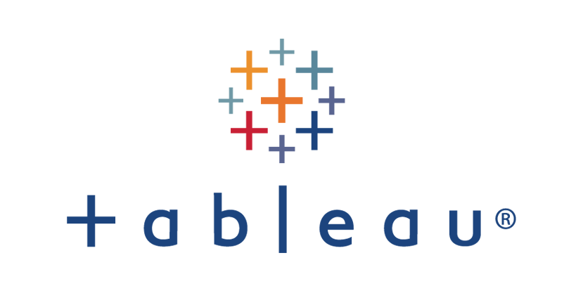
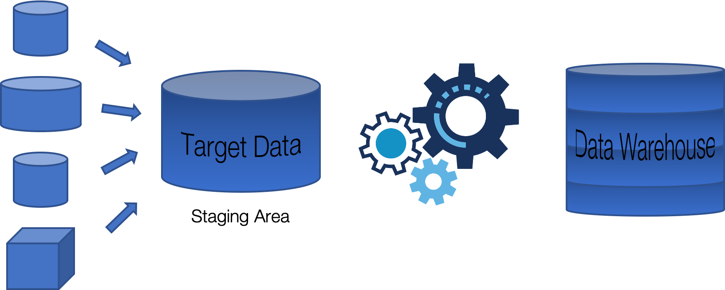



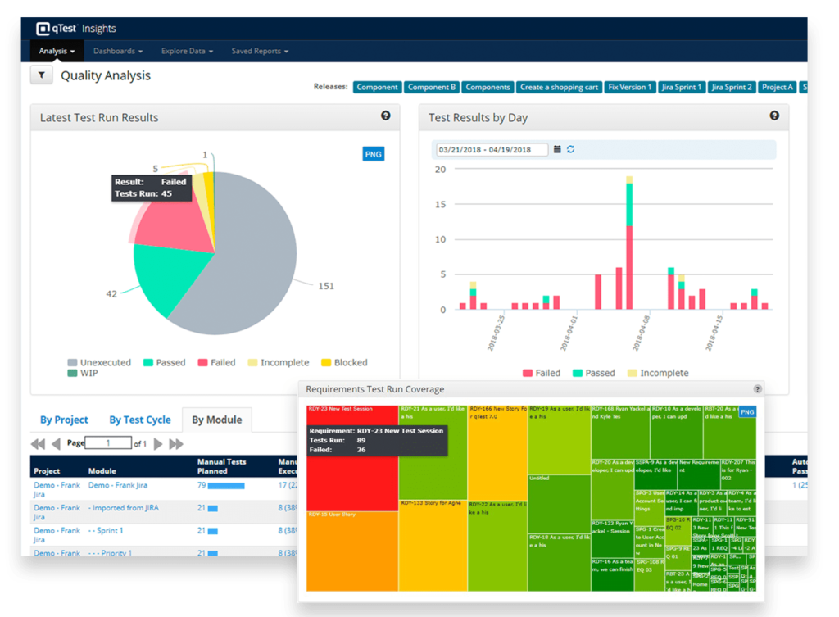
Basic ETL Process
Selection of data aka extraction
Reporting Schema
Loading of data
Transformations
Separate raw data

Slide 11

Data Extraction
QA as much of the data before we make is available
Keep history of all raw data
Best Practices
Reconcile records with the source data
Make sure that no spam/unwanted data loaded
Data type check
STRING, INT, BOOLEAN, DATE
Remove all types of duplicate/fragmented data
Check whether all the keys are in place or not
Did the data shift due to an extra comma
Notes:
Data extraction involves extracting data from homogenous or hetrogenous sources.
So all the data exists in your data warhouse Snowflake, but it is in the raw format and it does not give any insights. We need to be smart about this. Here is an opportunity to QA much of the data before we make is available to pleabs

Slide 12
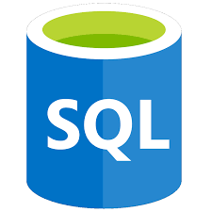
SQL Extraction
What does SQL stand for?
Structured Query Language
It is based on relational algebra
Intersect, union, differences
1986 – ANSI (American National Standards Institute) designated it a language
1987 – ISO (International Standards Organization) followed suit
There are different versions - but only subtle changes – basic syntax
Data manipulations – DML
Data Definitions – DDL
Most relationship data bases are row oriented and columnar

Slide 13
Row Oriented and Columnar
Objects and Attributes
Attributes, Variables, Fields, Features, Characteristics
4 main Data types
Nominal - categories
Discrete
Ordinal - categories with order
Interval - distinctness, order, addition
Continuous
Ratio - distinctness, order, multiplication
Objects
Records
Points
Samples
Instances
Cases
Entities

Slide 14




API Source Extraction
What is an API?
Application Programming Interface
Set of functions and procedures allowing the creation of applications that access the features or data of an operating system, application, or other service
Limits
Need more data than is available
Notes:
Let’s talk Facebook – back in the day when they first came out they gave you all the data – demographics, details, likes, dislikes
Turns out that data was actually really valuable and could be used to do some pretty bad things
Facebook got in trouble – First they limited the API pulls but turns out you could still scrape and crawl the site
Facebook got in trouble again!
Twitter still allows for some scraping
Reddit too
Surprising the information you can learn about a person based off of forums
But data security is a completely different lecture when you might leave with your heads and your phones wrapped in foil (my attempt at a joke)

Slide 15
File reading Extraction
In computing, Configuration files are used to configure the parameters and initial setting for a computer program
Commonly know as config files
Used in user applications, server processes, and operating systems
Essentially preferences for building and/or running a program
Some config files are structured in a format of the developer’s own design. Others use widely known standards used to structure data, like:
YAML
XML
JSON

Slide 16
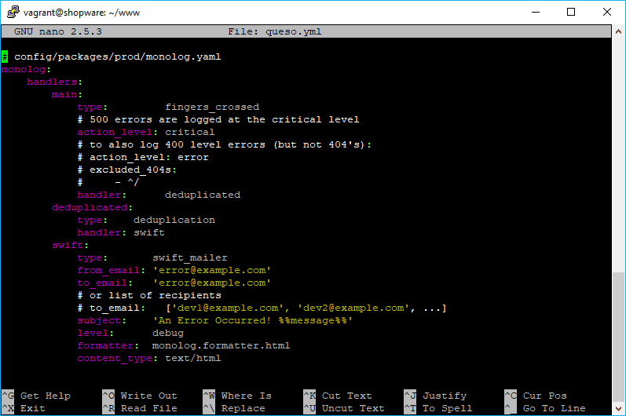
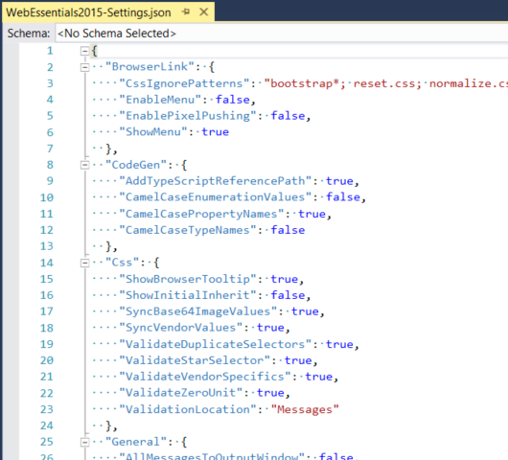
Config Files

Slide 17
YAML vs JSON vs XML
YAML “YMAL Ain’t Markup Language”
Human-readable data-serialization language that is commonly used for config files and in apps where data is being stored or transmitted
Targets many communication applications like XML
Uses python style indentation to indicate nesting, […] lists, and {…} maps
Custom data types are allowed
But stick to STRINGS, INT, and FLOATs
Uses the colon-centered syntax for expressing key-value pairs like JSON
JSON (readable only) is a subset of YAML (readable and editable)
data objects consisting of attribute–value pairs and array data types
XML is a markup language
defines a set of rules for encoding documents in a format that is both human-readable and machine-readable
Notes:
Recursive acronym YMAL refers to itself in it

Slide 18
Transforming
Data from the source is raw and might not be usable
It needs to be…
Cleaned
Mapped
Transformed
Data that does not need to be transformed is called “pass through” or “direct move” data
Validations are also done during this step
What are some examples of transformations and validations

Slide 19
Examples of Transformations
Different spelling of the same person like Jon, John, etc
There are multiple ways to denote company name like Google, Google Inc
Use of different names like Cleaveland, Cleveland
There may be a case that different account numbers are generated by various applications for the same customer – and we need to link the accounts
In some data required files remains blank or null
Invalid product collected at POS as manual entry can lead to mistakes.
Merging data with errors back into main data set (Snowflake helps with this)

Slide 20
Examples of Validations
Filtering – Select only certain columns to load
Using rules and lookup tables for Data standardization
Character Set Conversion and encoding handling
Conversion of Units of Measurements like Date Time Conversion, currency conversions, numerical conversions, etc.
Data threshold validation check. For example, age cannot be more than two digits.
Data flow validation from the staging area to the intermediate tables.
Required fields should not be left blank.
Split a column into multiples and merging multiple columns into a single column.
Transposing rows and columns,
Use lookups to merge data
Using any complex data validation (e.g., if the first two columns in a row are empty then it automatically reject the row from processing)

Slide 21
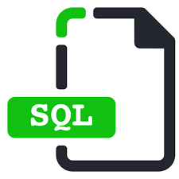
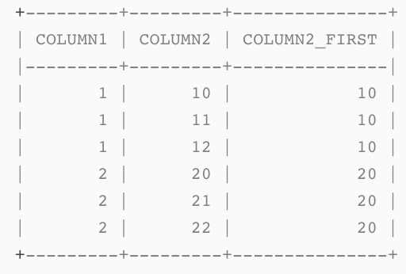
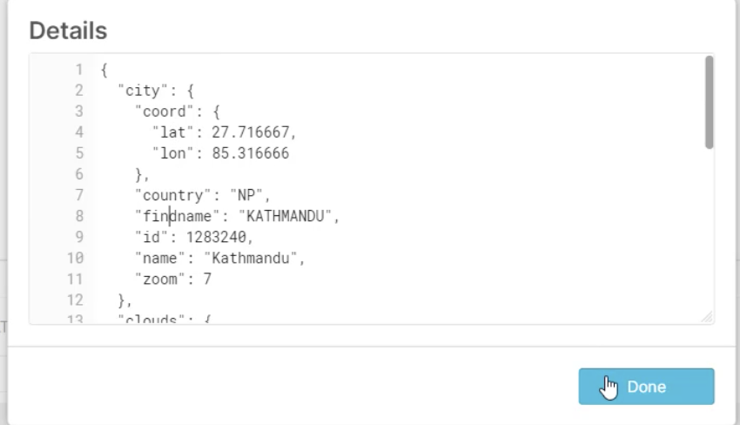
Transforming in Code
Windowing functions Aggregate functions
Working with semi-structure data
select column1, column2, first_value(column2) over (partition by column1 order by column2) as column2_first from values (1, 10), (1, 11), (1, null), (1, 12), (2, 20), (2, 21), (2, 22);
select column1, column2, AVG(column3),
MAX(column3), MIN(column3)
from values (1, 10), (1, 11, 4), (1, null, 5), (1, 12, 6), (2, 20, 8), (2, 21,3), (2, 22,1);
-- using json dot in snowflake rather than regex
SELECT v:city.coord.lat as lat, v:city.country as country FROM weather
-- can also use square bracket notation
SELECT src['salesperson']['name’] FROM car_sales;
-- there is also the parse json function
select column1 as n, parse_json(column2) as v from values (1, 'null'), (2, null), (3, 'true')

Slide 22
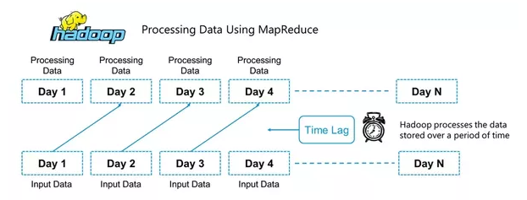
Batch Loading vs Streaming
Batch processing is where the processing happens of blocks of data that have already been stored over a period of time
When will batch processing work well?
Notes:
For example, processing all the transaction that have been performed by a major financial firm in a week. This data contains millions of records for a day that can be stored as a file or record etc. This particular file will undergo processing at the end of the day for various analysis that firm wants to do. Obviously it will take large amount of time for that file to be processed. That would be what Batch Processing is :)
When will batch processing work well?
Don’t need real time analytics results

Slide 23
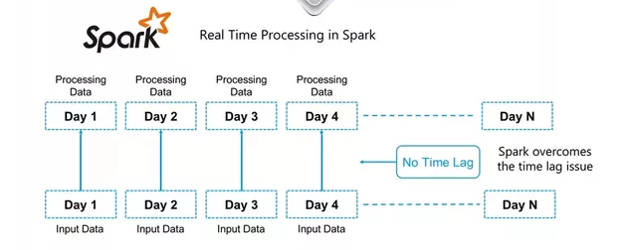
Batch Loading vs Streaming
Stream processing allows us to process data in real time as they arrive and quickly detect conditions within small time period from the point of receiving the data
When Is an example of when stream processing most useful?
What’s the issue?
Notes:
Stream processing is a golden key if you want analytics results in real time
So this is what we need? Right?! Why not do this with all data?
Stream processing allows you to feed data into analytics tools as soon as they get generated and get instant analytics results.
multiple open source stream processing platforms such as Apache Kafka, Apache Flink, Apache Storm, Apache Samza, etc.
You can query data stream using a “Streaming SQL” language
When Is an example of when stream processing most useful?
Fraud detection

Slide 24

Batch Loading vs Streaming Differences
Batch Loading | Streaming
Processes over all or most of the data | Processing it processes over data on rolling window or most recent rec
handles a large batch of data | handles Individual records or a few records at a time
latency will be in a days to hours | latency will be in seconds or milliseconds
So is there an in-between???

Slide 25
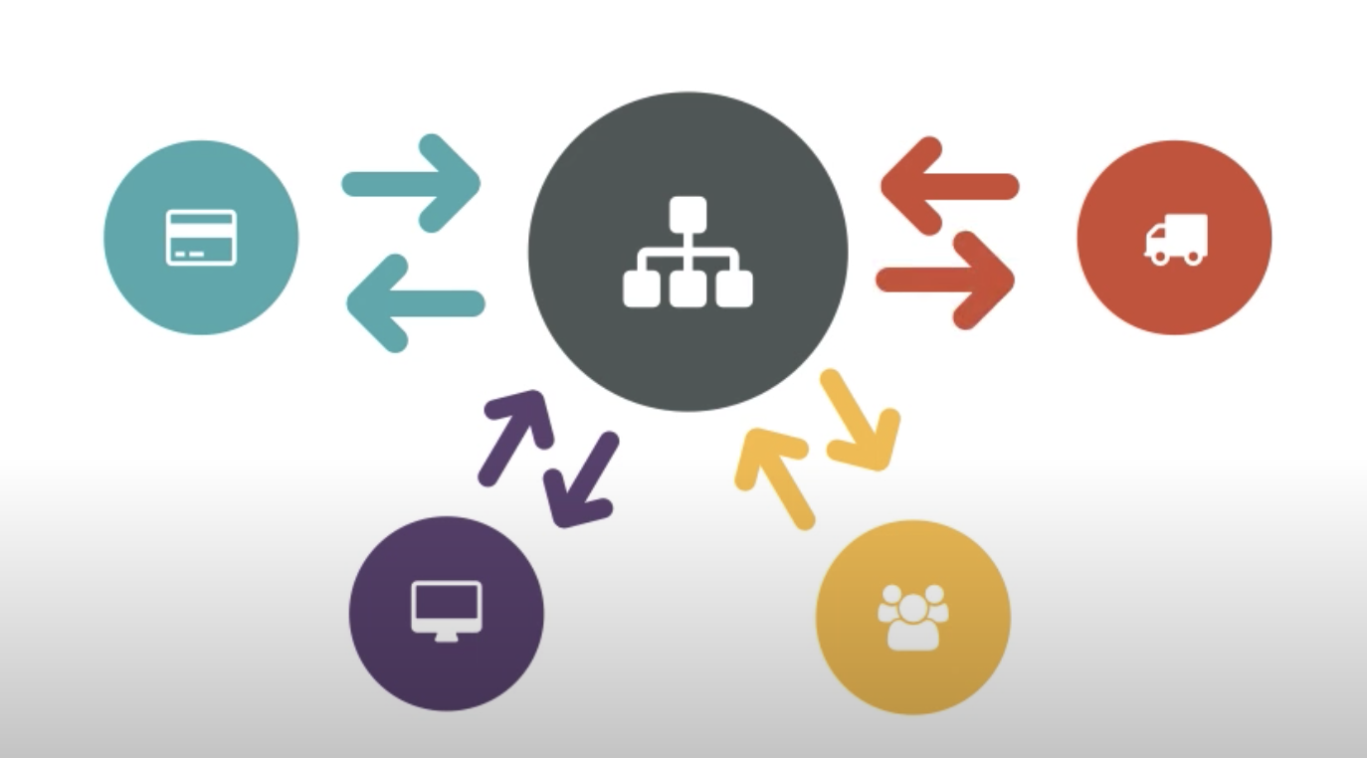
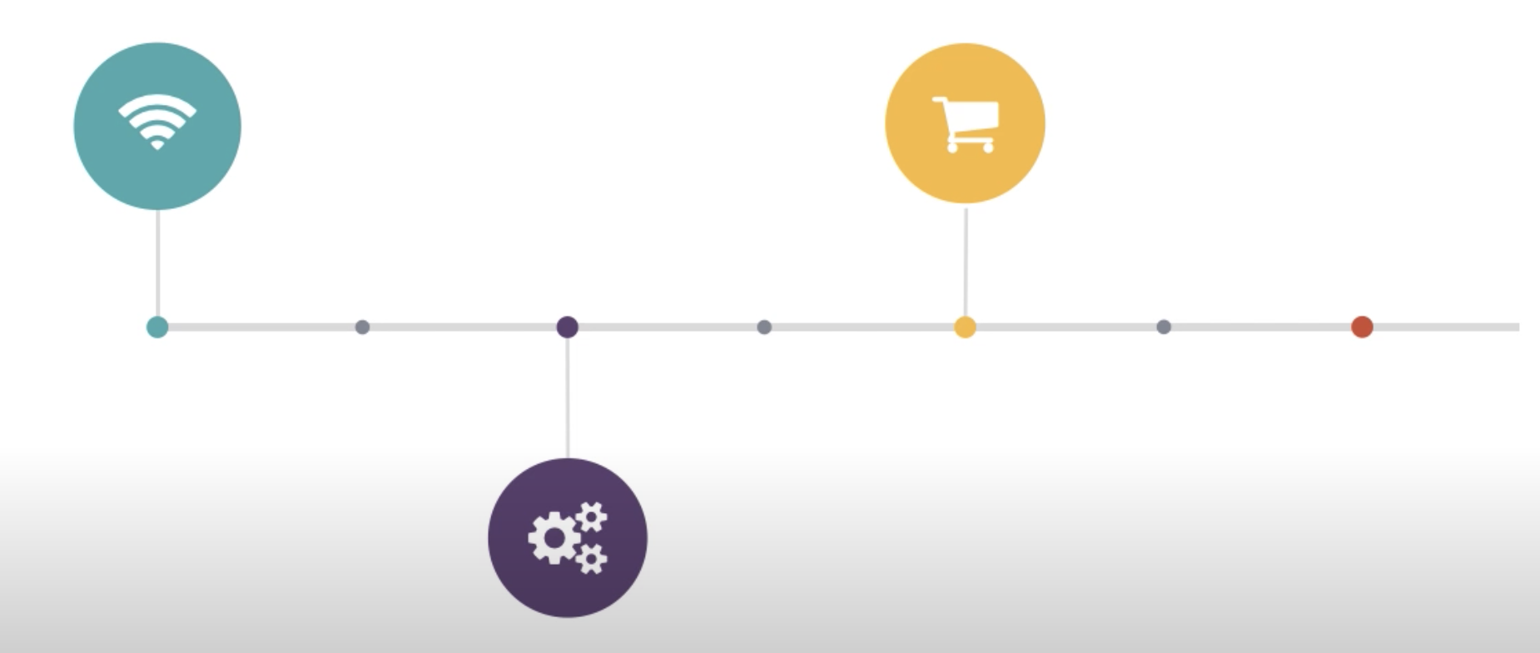
Event Driven vs Batch Architecture
Several trends in computing have surfaced in recent years: big data, containers, serverless application, microservices, and event-driven architecture (EDA)
Notes:
The popularity has grown because companies know they can move faster to deliver a scalable solution that are much more manageable than monolithic applications.
In the mid-2000s, N-tier architecture was at its height of popularity. Organizations would build monolithic code bases backed by an RDBMS against which all CRUD was performed
Object oriented programming encouraged engineers to reuse code – not their fault
Centralized – constrained by centralized system
event waits on central system- > batch processes -> returned to central system - > then sent to consumer after some time
EDA – event creator -> event manager - > event consumers
Advantages
EDA
- loosely coupled structure – work well – used and reused
Versatility – normalized to unpredictable, non-linear, asynchronous enviroments
Real time analytics – pre-emptive world – focus on what is happening vs analyzing what happened before
Complex event processing – identify meaningful events and respond before or as soon as they happen
Disadvantages
Don’t know what events are a part of it – dependencies might become opaque
Algorithmic trading – no one has full view of what is happening – granted it prevents full arbitrage (changes over time)
Get very complex – increases cost

Slide 26


Event Driven
EDAs could very likely be a sledgehammer for your problem when you instead need a screwdriver
What is the right level of fidelity of service abstraction?
Are your event messages schema or schema-less?
How does your system handle failures caused by bad or corrupt data, downed services or queues?
How do you handle a noisy neighbor problem?
How will you debug and understand the flow of events through the system?
How do you handle events that are not idempotent?
How will your system handle cycle prevention and detection?
How will your system handle rollback of a distributed transaction?
Notes:
Take into account the cost of development and maintenance when deciding if this is the right solution for you
Don’t bring a knife to a gun fight … well don’t bring a sledge hammer when a screw driver will suffice
What is the right level of fidelity of service abstraction?
Are your event messages schema or schema-less?
How does your system handle failures caused by bad or corrupt data, downed services or queues?
How do you handle a noisy neighbor problem?
How will you debug and understand the flow of events through the system?
How do you handle events that are not idempotent?
denoting an element of a set which is unchanged in value when multiplied or otherwise operated on by itself.
How will your system handle cycle prevention and detection?
How will your system handle rollback of a distributed transaction?

Slide 27

What Architecture is right for your team?
Mini Lab Breakout Is Event driven Architecture right for you?
Notes:
Think about your data and discuss how this architecture would benefit your team or not
Come up with 3 pro and cons
We don’t need specifics on the data that you are thinking about

Slide 28
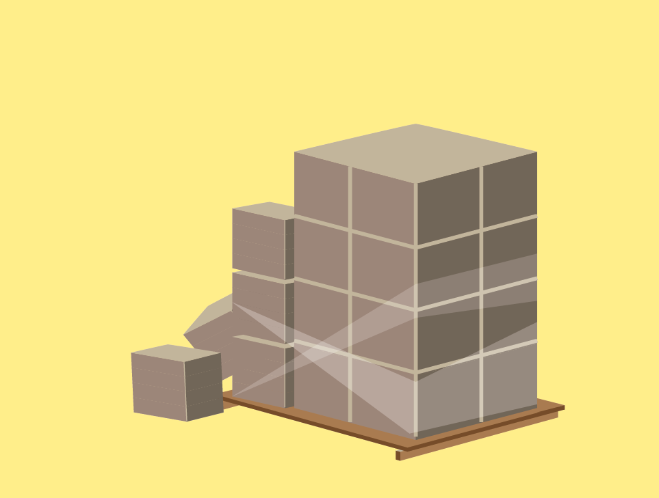
Loading
Types of Loading
Initial Load — populating all the Data Warehouse tables
Incremental Load — applying ongoing changes as when needed periodically.
Full Refresh —erasing the contents of one or more tables and reloading with fresh data.
Load Verification
Ensure that the key field data is neither missing nor null
Test modeling views based on the target tables
Check that combined values and calculated measures
Data checks in dimension table as well as history table
Check the BI reports on the loaded fact and dimension table
Notes:
Loading data into the target data warehouse database is the last step of the ETL process.
In a typical Data warehouse, huge volume of data needs to be loaded in a relatively short period (nights). Hence, load process should be optimized for performance.
In case of load failure, recover mechanisms should be configured to restart from the point of failure without data integrity loss.
Data Warehouse admins need to monitor, resume, cancel loads as per prevailing server performance
Plan to set up multiple integrity checks - this will notify you before it’s too late

Slide 29


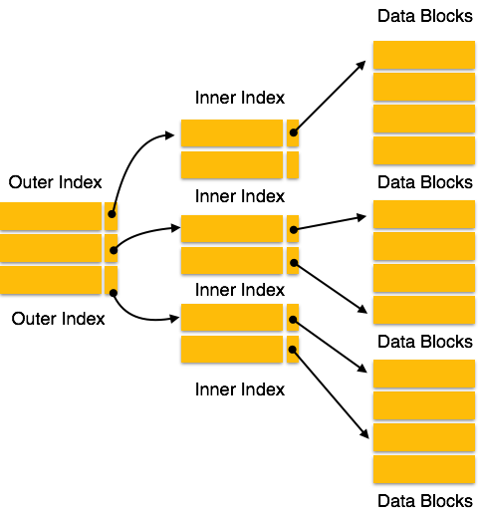
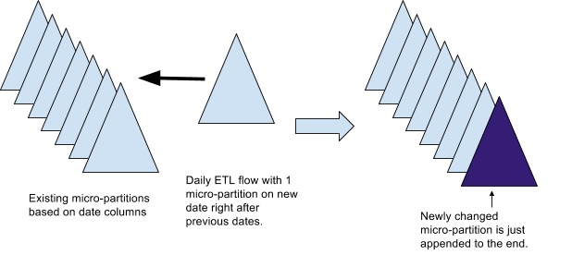
Index Loading
Indexes are used to quickly locate data without having to search every row in a database table every time a database table is accessed
An index is a copy of selected columns of data from a table, called a database key or simply key, that can be searched very efficiently that also includes a low-level disk block address or direct link to the complete row of data it was copied from
Notes:
A database index is a data structure that improves the speed of data retrieval operations on a database table at the cost of additional writes and storage space to maintain the index data structure
This is great and all but as you all should know from your snowflake class this is of the past!
The future is snow … ok micro partitions
We will deep dive into this on day 3 in an intensive lab that looks under the hood of what snowflake is doing – get excited!!!

Slide 30
Dim vs Fact
Fact table contains business facts (or measures), and foreign keys which refer to candidate keys (normally primary keys) in the dimension tables
Dimension tables contain descriptive attributes (or fields) that are typically textual fields (or discrete numbers that behave like text). These attributes are designed to serve two critical purposes: query constraining and/or filtering
Dimension attributes should be:
Verbose and descriptive
labels consisting of full words
Complete
Discretely valued
One value per row
Quality assured
Keep it clean
Dimension can change over time
Type One - Simply overwrite the old value(s).
Type Two - Add a new row containing the new value(s)
Type Three - Add a new attribute to the existing row
Notes:
These attributes are designed to serve two critical purposes: query constraining and/or filtering, and query result set labeling.
Types of facts
Additive – measures should be added to all dimensions
Semi- additive – measures may be added to some dimensions but not with others
Non-additive – it stores some basic unit of measurement of business process
Sales
Phone calls
Orders

Slide 31
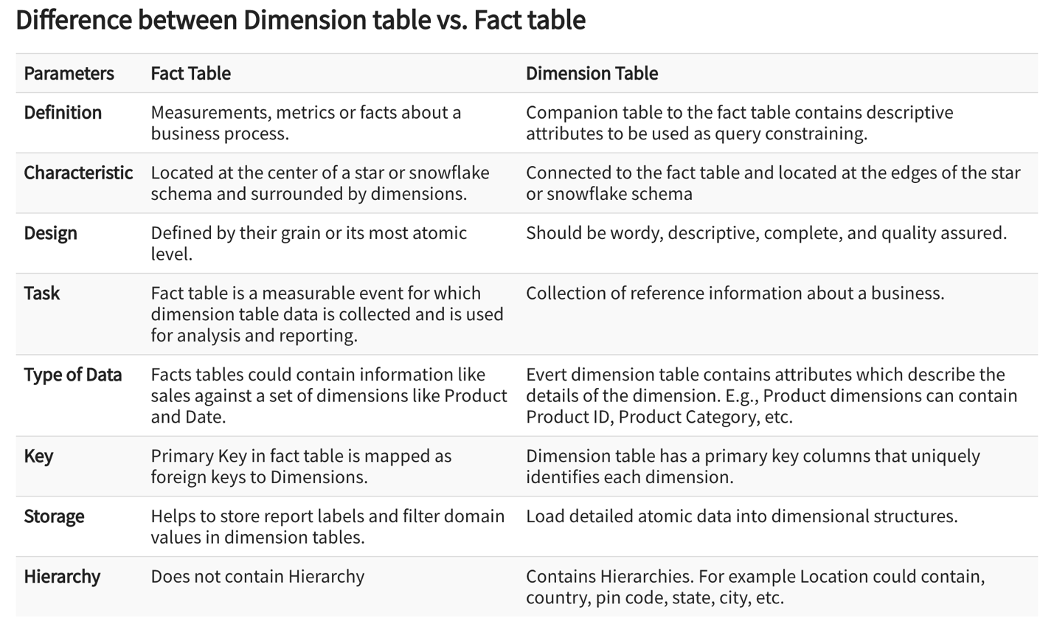
Dim vs Fact

Slide 32
Best Practices in ETL
Best Practices
Never try to cleanse all the data
Never cleanse nothing
Determine the cost of cleansing the data
Maybe sampling is sufficient
To speed up query processing, have auxiliary views
Trade-off at the level of granularity of data to decrease the storage costs.
Notes:
Every organization would like to have all the data clean, but most of them are not ready to pay to wait or not ready to wait. To clean it all would simply take too long, so it is better not to try to cleanse all the data
Always plan to clean something because the biggest reason for building the Data Warehouse is to offer cleaner and more reliable data.
Before cleansing all the dirty data, it is important for you to determine the cleansing cost for every dirty data element
To reduce storage costs, store summarized data

Slide 33

Confused? ASK QUESTIONS

Slide 34
Break & Lab1
Notes:
Take a data set how would you set up the Schemas

Slide 35
AWS Cloud Fundamentals
Kerry Nakayama

Slide 36
AWS Regions

Slide 37
IAM User and Permissions

Slide 38
Creating and Managing Virtual Machines with EC2

Slide 39
Provisions

Slide 40
Networking (Virtual Private Cloud)

Slide 41
Storage

Slide 42
Moving Data in the Cloud

Slide 43
Transforming Data

Slide 44
Traditional vs Cloud Data Warehousing

Slide 45

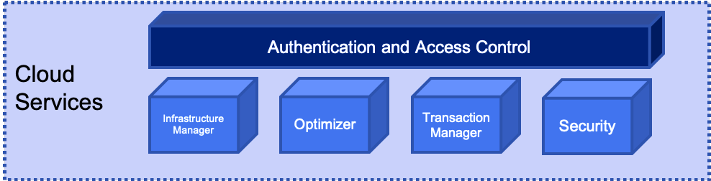
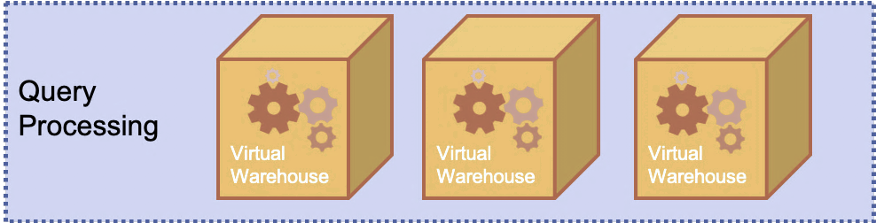
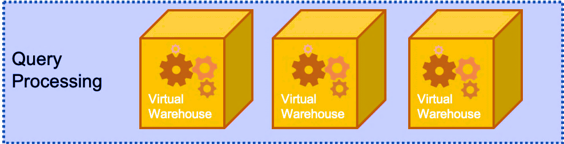
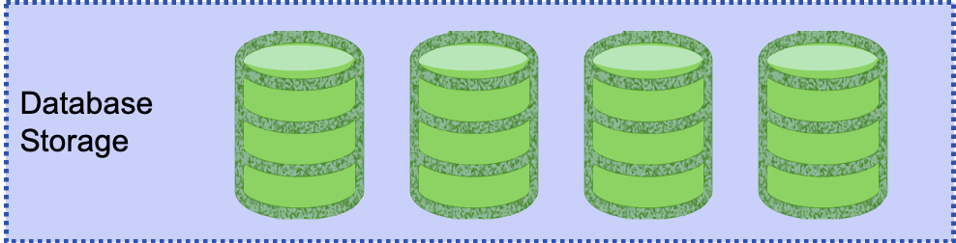
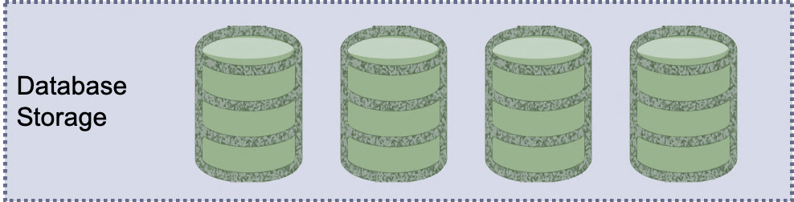
Snowflake is a hybrid of Shared Nothing and Disk
So how does Snowflake address these shortcomings?
Snowflake is Elastic!
Notes:
The idea here is that by using the cloud based infrastructure SNOWFLAKE can essentially throw resources at the management of shared-nothing infrastructure indefinitely.
This is because Snowflake is elastic in nature- it will expand as resources are required and contract when not required.
This addresses both the high compute requirements of Shared Nothing AND the high-cost requirements of creating “workers”

Slide 46
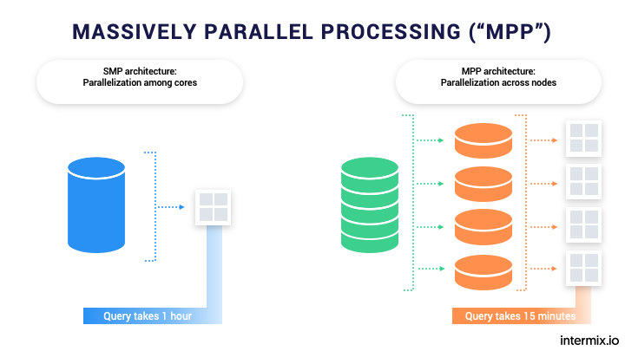
Massive Parallel Processing
Snowflake is a shared-nothing or massive parallel processing system.
Imagine if you will, for a minute, a series of workers, each of whom have their own memory, resources, and processors assigned to a task.
We can split the task among these workers thereby speeding up the task immeasurably.
“MPP is the coordinated processing of a program by multiple processors that work on different parts of the program, with each processor using its own operating system and memory”

Slide 47
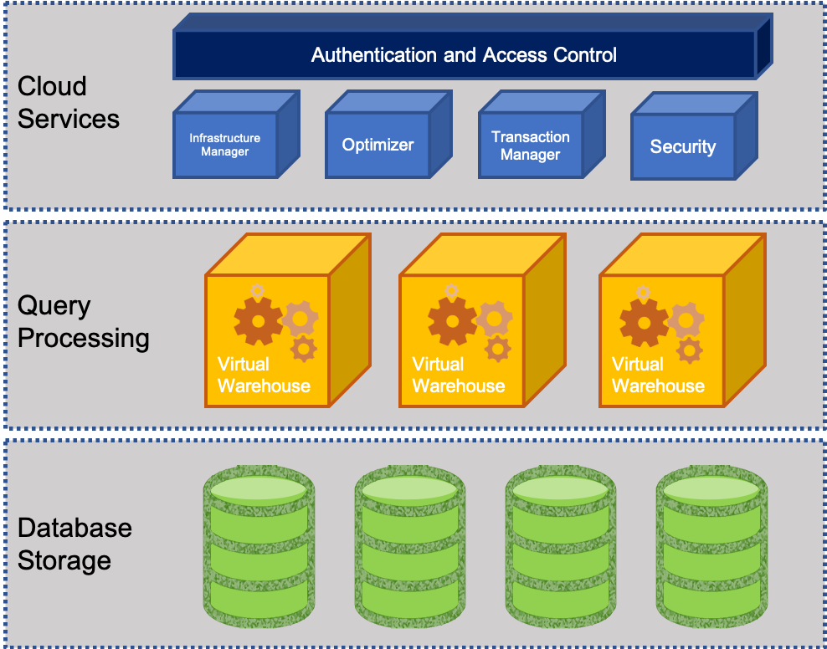
What does Snowflake offer?
Let’s divide data warehouses into three parts:
Storage: for storing data and
Computing: which is what allows us to do all the things we do in structured SQL databases
Services: Which are some of the things like pipelines, etc.
Snowflake offers us the opportunity to independently scale the storage, services, and the computing. Why is this important?

Slide 48
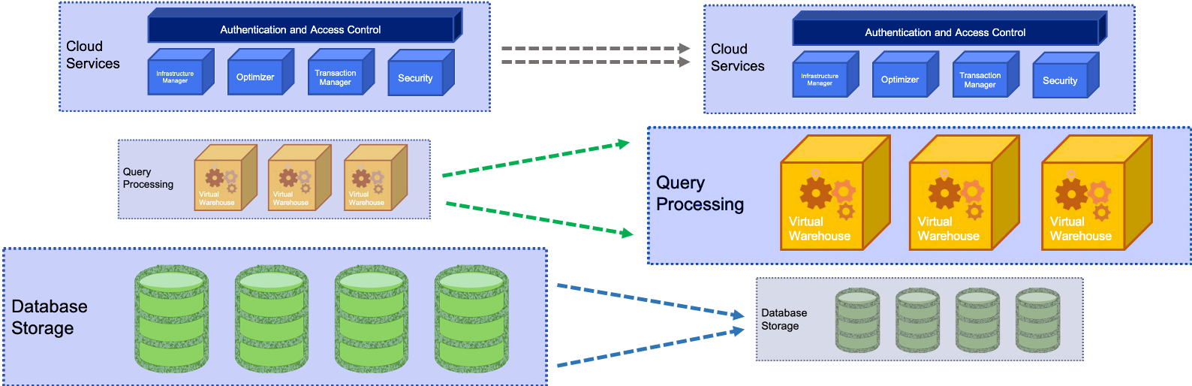
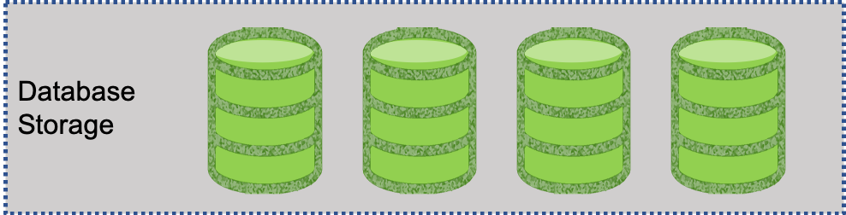
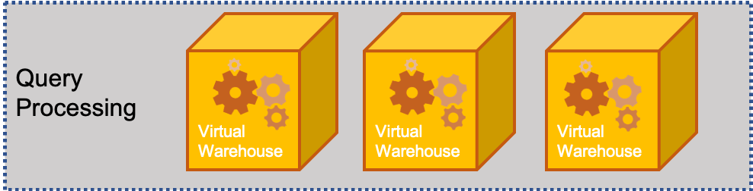
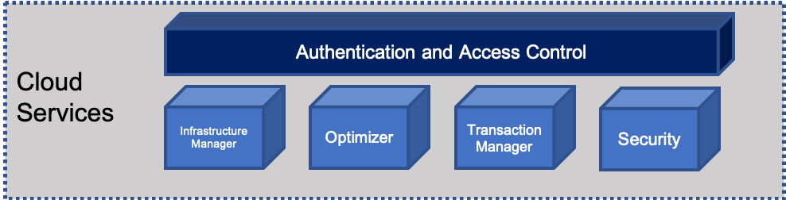
Snowflake Elasticity
Snowflake has a novel concept to deal with elasticity:
This means that we can deal with the DATA STORAGE, COMPUTE and USERS (Services) layer without effecting the other ones
DATA
Services
Compute
Notes:
By isolating each layer they can expand and contract independently of each other.
This means that we can deal with the DATA STORAGE, COMPUTE and USERS (Services) layer without effecting the other ones.
Let’s go into each of these
DATA - The amount of data stored can be increased or decreased at any time.
- Data and compute decoupled – is determined independently of the volume of data in the system
- store data at a very low cost because no compute resources are required to store data in the database
COMPUTE – these resources that are being used for query processing can also be scaled up or down depending on the intensity of the workload on the system changes.
- remember - storage and compute are decoupled,
- data is dynamically distributed
- changing compute resources does not require reshuffling the data
- Compute resources can be changed on-the-fly, without disruption.
SERVICES – with other systems as more users come on the the resources are strained and everything becomes much slower
- other system solution is to create a new datamart
- extra management burden
- replicating and/or migrating data across systems
- Snowflake can scale to support more users and workloads without performance impact because multiple virtual warehouses can be deployed on-demand, all with access to the same data.

Slide 49
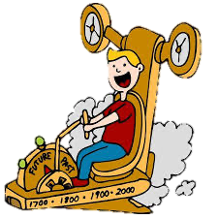

Snowflake Automation
So now let’s talk about a lot of the “under the hood” things that Snowflake can do for us, including:
Time Travel:
Enables you to immediately revert any table, database or schema to a previous state. It’s enabled automatically and stores data as it’s transformed for up to 24 hours, or 90 days in enterprise versions.
Copying to clone:
Most data warehouses require you to copy data to clone, forcing a large amount of manual effort and a significant time investment.
Snowflake’s multi-cluster, shared data architecture ensures that you never need to copy any data, because any warehouse or database automatically references the same centralized data store

Slide 50

Snowflake Automation
Data distribution:
Managed automatically by Snowflake based on usage.
Snowflake automatically manages how data is distributed in the virtual warehouse
Other systems rely on a static partitioning scheme based on a distribution algorithm or key chosen by the user at load time
Data is automatically redistributed based on usage to minimize data shuffling and maximize performance.
Loading Data:
Complex ETL data pipelines are no longer needed to prepare data for loading. Snowflake natively supports and optimizes diverse data, both structured and semi-structured, while making that data accessible via SQL.

